Slide 1
Causal and Sequential Decision Models for Fault Identification
Christian Adriano
System Analysis and Modeling Group
Prof. Dr. Holger Giese
Notes:
Questions asked:
Prof. P. - What about dynamic programming languages? More complex bugs would require more information for the programmer to understand the fault, e.g., internal states, type casting operations, race conditions, etc. I do not provide this information to programmers. However, I do not
What about different programming languages and context/methodology involved?
What about using synthetic bugs (fault injection)?
Prof. N – What about suggesting the correct line of code?
Prof. G – Could you include the cost and availability of recruitment? What is the difference between tasks that cover more or less lines of code? How do you handle it and how it affects predictions?
Be more principled on the reasons you give for certain models working and others not.

Slide 2
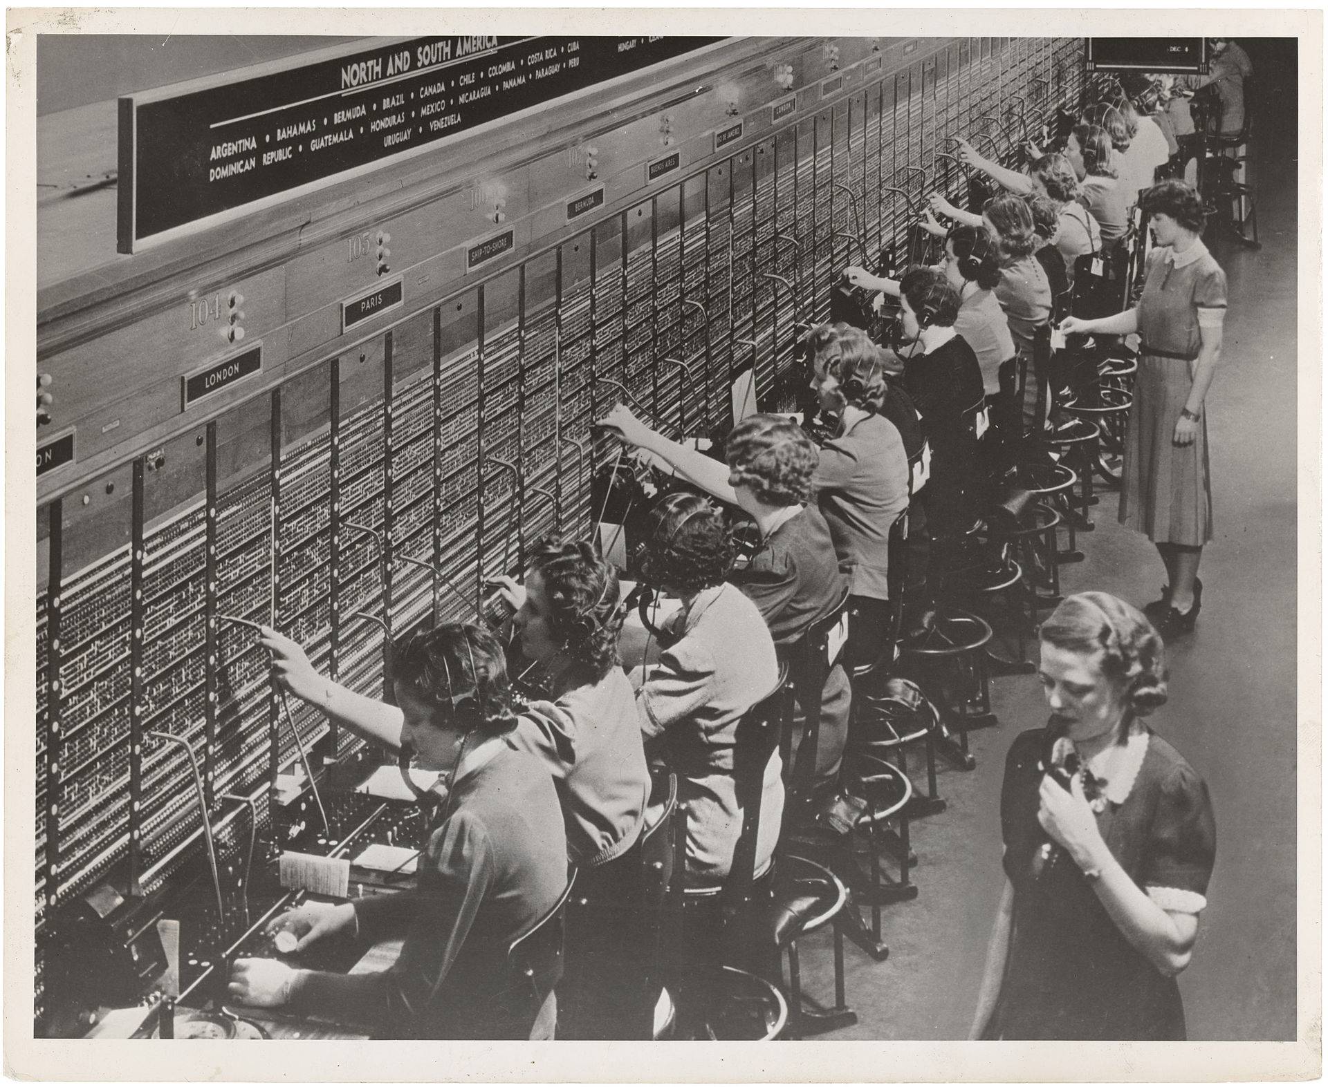
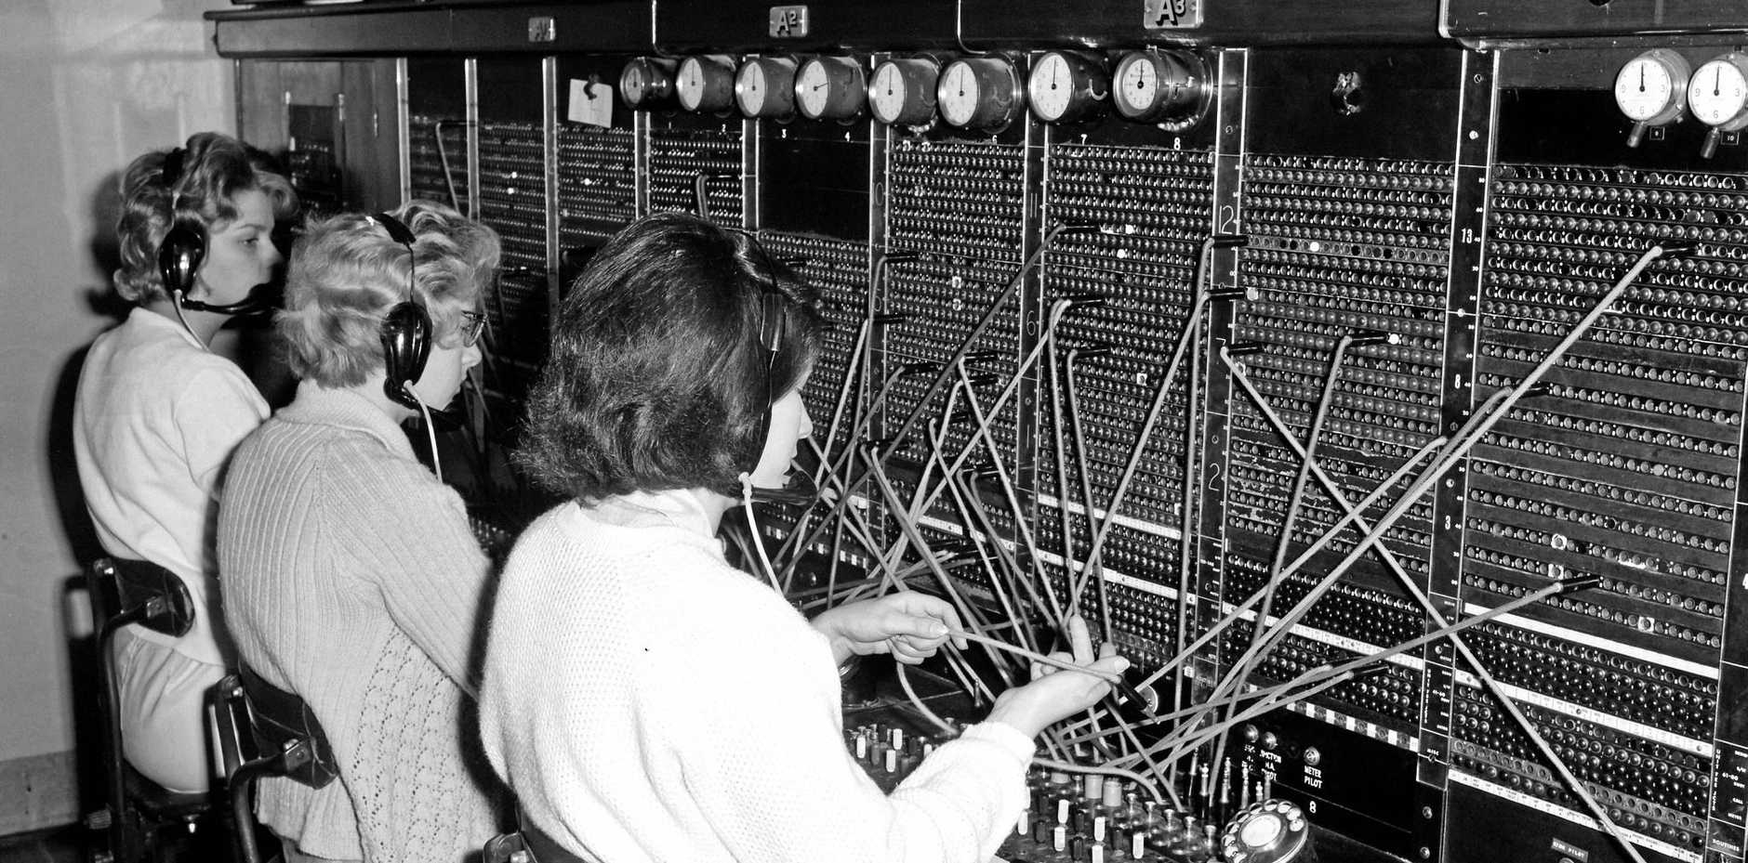
Once upon a time in the 1940’s
1940:
350.000 telephone operators [Eth 2019]
18.2 million working women
2% of women work force
2020:
4.4 million softw. developers [Daxx 2020]
158 million working people
2.6% of US work force
Notes:
[Daxx 2019] https://www.daxx.com/blog/development-trends/number-software-developers-world
Since every new phone added exponentially in terms of number of connections needed, very soon people started predicting that all women in US will have to be employed as phone operators.
Number of students who took AP Calculus AB (2018, http://bit.ly/2sHB1cU): 308,537
Number of students who took AP Calculus BC (2018, http://bit.ly/2sHB1cU): 139,376
Total: 347,913Compared to the 15.3-million high schools students in the U.S., this is about 2%.

Slide 3
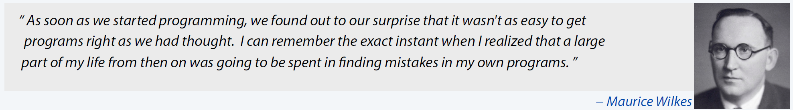
Debugging is time consuming
Time spent debugging (industry surveys):
10 to 35% [Tassey 2002]
50% [Britton et al. 2013]
20 to 40% [Perscheid et al. 2017]
Turing Award 1967
Inventor of microprogramming 1951
source: Wikipedia
Time spent debugging (industry surveys):
35% [Tassey 2002]
50% [La Toza, Venolia & De Line 2006] [Britton et al. 2013]
40% [Perscheid, Hirschfeld et al. 2017]
Notes:
Various industries surveys have confirmed over the time that programmers spend from 20% to 50% of their time debugging software. Why is debugging time consuming? Because it is very difficult. Various studies looked at the reasons of difficulty. To do that, they compared how expert and novices debug software.
Computer Scientist Turing Award 1967
Inventor of stored-program computer 1949, macros, subroutine libraries, microprogramming 1951
source: Wikipedia
[Tassey 2002] G. Tassey, “The economic impacts of inadequate infrastructure for software testing,” National Institute of Standards and Technology, RTI Project, vol. 7007, no. 011, 2002.
[La Toza, Venolia & De Line 2006] LaToza, T.D., Venolia, G., & DeLine, R. 2006. Maintaining mental models: a study of developer work habits. In Proceedings of the 28th international conference on Software engineering (ICSE '06). ACM, New York, NY, USA, 492-501. DOI: https://doi.org/10.1145/1134285.1134355
[Britton et al. 2013] Britton T, et al., Reversible Debugging Software “Quantify the time and cost saved using reversible debuggers”, Report, University of Cambridge Report, 2013
[Perscheid et al. 2017] Perscheid, M., Siegmund, B., Taeumel, M., and Hirschfeld, R. Studying the advancement in debugging practice of professional software developers. Software Quality Journal 25, 1 (Mar. 2017), 83–110.

Slide 4
Debugging in the 90s
Program slicing by Mark Weiser 1979
programmers reasoned about dependencies while trying to find suspicious code (slides)
Algorithmic Debugging by Ehud Y. Shapiro 1982
programmers narrowing down the cause of failure by posing questions of whether a program state was correct
Debugging is the “dirty little secret” of software engineering by Henry Lieberman 1997
Lack of proper tooling
The Cathedral and the Baazar by Eric S. Raymod 1999
“given enough eye-balls, all bugs are shallow” Eric S. Raymond citing Linus Torvald
Hundreds of programmers can now collaborate in a loosely decentralized manner in Open-Source Projects – Roy Fielding et al. 2002
Notes:
Lieberman, Henry. "The debugging scandal and what to do about it." Communications of the ACM 40.4 (1997): 26-30.
Shapiro, Ehud Yehuda. Algorithmic program debugging. PhD Thesis, MIT, 1982.
Weiser, Mark. "Program slicing." IEEE Transactions on software engineering 4 (1984): 352-357.
Mockus, Audris, Roy T. Fielding, and James D. Herbsleb. "Two case studies of open source software development: Apache and Mozilla." ACM Transactions on Software Engineering and Methodology (TOSEM) 11.3 (2002): 309-346.
“given enough eye-balls, all bugs are shallow” == given a large enough team, someone will deem the bug obvious

Slide 5
Why is debugging so time consuming?
Insights from Research Studies with Experts versus Novices
Experts generated better hypotheses [Gugerty & Olson 1986]
test fewer hypotheses
Experts are more disciplined in their investigation [Vissey 1996]
study the source code more carefully
build better mental models
Experts use abstractions to talk about the program [La Toza et al. 2007]
better at identifying problems and
explaining the facts about the source code
4. Debugging remains (possibly) the most difficult task in software engineering because it is essentially unbounded
Heavy reliance on ad hoc tests, instead of statics and dynamic analysis tools [Parnin & Orso 2011] also do not help much, as strong reliance on quality of test sets and
Heavy use of prints instead of debugger [Beller et al. 2018]
Notes:
Generating hypotheses about the problem is difficult
Requires a discipline behavior
Understanding the source code is difficult
Identifying problems and explaining facts is difficult
Hence the task is too difficult because it is unbounded
Beller, Moritz, et al. "On the dichotomy of debugging behavior among programmers." Proceedings of the 40th International Conference on Software Engineering. 2018.

Slide 6
Debugging techniques
Approach | Tool examples | Pre-requisites | Tasks
Algorithmic debugging | DDJ [2010], Whyline [2004] | Reproducible failure | Answer sequential questions about intermediate program states
Static analysis | PMD, JLint, FindBugs | Pre-defined patterns | List of warnings about program statements that matched code problem pattern
Knowledge-base debugging | HelpMeOut [2010], CrowdDebug [2015] | Representative data | Recommendations on how to fix a software failure or coding problem
Statistical fault localization | Tarantula [2008], Enlightened [2018] | Reproducible failure Balanced unit tests | List of suspicious source code sorted by participation in failed test executions
Distributed debugging | CrowdOracles [2013], CrowdCode [2014], Bugbounties [2019] | Failure description | A failed test description and the corresponding code to be inspected.
Notes:
Several debugging techniques and tools were developed to help make debugging easier. Each in their own way, all techniques narrow the number of lines of code that the programmer will have to inspect. When effective, these techniques narrow to the lines, among which the fault is located. For instance, Algorithmic debugging tasks are …., Static analysis tasks are …
Automated tools
Static analysis tools (PMC and FindBugs) add study from [Amann et al 2018]
Statistical fault localization
Lack of Fault Understanding (Parnin & Orso 2011)
Do not cover all types of bugs and/or depend on the quality of the unit tests
[Amann-etal-2018] Amann, S., Nguyen, H. A., Nadi, S., Nguyen, T. N., & Mezini, M. (2018). A systematic evaluation of static api-misuse detectors. IEEE Transactions on Software Engineering.
Manual tools
Interactive debugging – Whyline [2008], Enlightened Debugging [2018]
Crowd-enriched data - BlueFix [2012], Crowd::Debug [2011], Help me out [2010], Bugfix [2009]
Crowd debugging – Crowd Oracles [2013], CrowdCode [2014]
Depend on professional programmers and/or do not support concurrent work
Not all crowdsourced debugging generate tasks, for instance, Bug Bounties consists of generic open call without any list of tasks partitioning the investigation for bugs.

Slide 7
The Imperfect Fault Understanding Phenomenon
Human-Aspect
There’s no guarantee that a programmer will recognize a program statement as faulty
And no guarantee of how many times it would take to recognize the fault
[Parnin & Orso 2011] Are automated debugging techniques actually helping programmers?, ISSTA, 2011
Tool-Aspect
There is uncertainty in the effectiveness of fault localization techniques across projects
And no self-evident and general source code factors that predict this effectiveness
[Golagha, Pretschner & Briand 2020] Can We Predict the Quality of Spectrum-based Fault Localization?, ICST, 2020
Notes:
[Golagha, Pretschner & Briand 2020] Can We Predict the Quality of Spectrum-based
Fault Localization
[Parnin & Orso 2011] ] Are automated debugging techniques actually helping programmers?., ISSTA
Why? Many fundamental reasons
*We are drawn to details that confirm our existing beliefs
*We discard specifics to form generalities
*We favor simple-looking options and complete information over complex and ambiguous options
*We store memories differently based on how we experience them
*We think we know what other developers were thinking
We project our current mindset and assumptions onto past and future
We fill in characteristics from stereotypes, generalities, and prior histories
We find stories and patterns even in sparse data
…

Slide 8
Why is Imperfect Fault Understanding not accidental?
Human-limitations (cognitive biases and heuristics [Gigerenzer et al. 2011])
are drawn to details that confirm their existing beliefs
favor simple-looking options over complex and ambiguous options
store memories differently based on how we experience them
think they know what another person was thinking
project their current mindset and assumptions onto past and future
fill in characteristics from stereotypes, generalities, and prior histories
find stories and patterns even in sparse data
The 4 Essential Difficulties of Software
[Brooks 1987]
Complexity
Conformity
Changeability
Invisibility
Tool-limitations [Golagha, Pretschner & Briand 2020]
Quality of unit tests
Coverage of unit tests
Imbalance in the unit test coverage
Complexity of the call-graph (Node degree, Diameter, Coupling )
[Brooks 1987] No-Silver Bullet: Essence and Accident in Software Engineering, Computer 20(4)
[Gigerenzer, Hertwig & Pachur 2011] Heuristics: The foundations of adaptive behavior. Oxford University Press
[Golagha, Pretschner & Briand 2020] Can We Predict the Quality of Spectrum-based Fault Localization?, ICST
Notes:
Gigerenzer, G. E., Hertwig, R. E., & Pachur, T. E. (2011). Heuristics: The foundations of adaptive behavior. Oxford University Press.
Gigerenzer G (2006). "Bounded and Rational". In Stainton RJ (ed.). Contemporary Debates in Cognitive Science. Blackwell. p. 129. ISBN 978-1-4051-1304-5.
Gerd Gigerenzer has criticized the framing of cognitive biases as errors in judgment, and favors interpreting them as arising from rational deviations from logical thought.^{[6]}
Defect prediction across projects
[Golagha, Pretschner & Briand 2020] Can We Predict the Quality of Spectrum-based Fault Localization?, ICST
Yuming Z., et al.,. 2018. How Far We Have Progressed in the Journey? An Examination of Cross-Project Defect Prediction. ACM Trans. Softw. Eng. Methodol. 27, 1, Article 1 (June 2018), 51 pages.
The four essential difficulties of writing software Fred Brooks identifies are:
Complexity The fact that computers are complex, have many states, software does not easily scale up, and does not lend itself to abstraction. Conformity The fact that software exists in an arbitrary environment filled with varying interfaces, standards, political decisions, etc. In order to work, the software must conform to these external factors. Changeability The fact that software is continuously subject to change. Software is constantly rewritten to meet new needs, and the people asking for changes often don't realize the difficulty as they would with changing a house or car. Also, successful software is ported to other environments and needs to be modified to work properly. Invisibility Software is invisible and unvisualizable. Therefore, there does not exist an easy way to represent it in a diagram, etc. (https://home.cs.colorado.edu/~kena/classes/3308/f06/reference/answers/hw01.html)

Slide 9
Working Definition for Fault Understanding
Fault Understanding consists of
the correct identification of the program statement that contains the code problem (bug) that is related to a given failure
an explanation of how the bug in the program statement contributes to the failure
Hence,
Fault Understanding precedes the systematic and iterative work of debugging, which requires proper scaffolding to reproduce the failure and test alternative fixes.

Slide 10
Towards Predictable & Actionable Fault Understanding?
What if we could predict if fault understanding is incorrect?
We could ask the developer to give a second look and improve her explanation.
Or ask another developer to give a second look.
What if we knew the probable causes of incorrect fault understanding?
We could give easier tasks to the current developer
Or redesign the tasks by giving programmers more contextual information (e.g., call graph, program state at failure)
Or recommend software refactoring to increase system maintainability (e.g., modularization, decoupling)

Slide 11
Research Problems
RP.1: What are the factors that can predict if a software fault was correctly recognized?
Approach: build causal inference models from quasi-experimental data
RP.2: How many replications are necessary to correctly recognize a software fault?
Approach: build sequential decision models based on Multi-Armed Bayesian Bandits
RP.3: Are bug fixes more accurate if programmers have access to the fault understanding explanations?
Approach: perform control experiment with the output of the causal and decision models

Slide 12
Experiment design (insight)
Fault understanding as a task is unbounded and faults are difficult to recognize.
Divide & Conquer
Divide & Conquer
Replication
Small & Independent Tasks
(Microtasks)
Small & Independent Tasks
(Microtasks)
Multiple Programmers per Task
(Crowdsourcing)
Notes:
One reason to have multiple programmers executing the same task is to determine if there is a consensus among the different programmers about the importance of an issue.

Slide 13

Experiment execution
1.Generate tasks
2.Sequence tasks
3.Distribute
tasks
Crowd of Programmers
no
bug located & explained?
yes
5.Aggregate outcomes
4.Execute
tasks

Slide 14
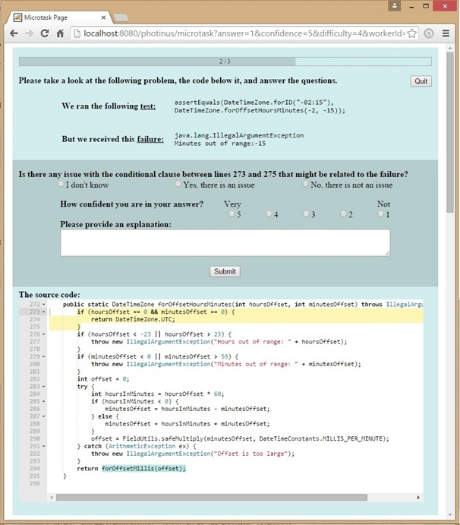
The microtask
Unit Test
1
Failure description
2
Question and Answers
3
Confidence
4
Explanation
5
Source code
6

Slide 15
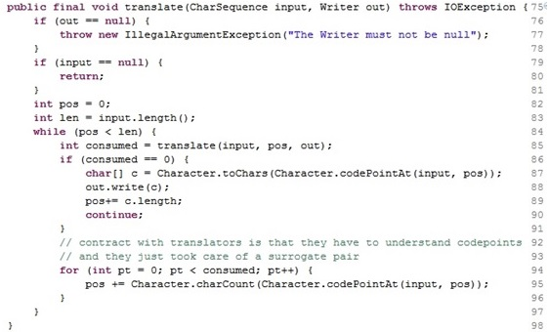
What is the granularity of the fault understanding?
QUESTIONS
q1
q2
q3
q4
q5
q6
q7
q8
no
no
yes
q2
no
yes
yes
yes
no
yes
no
no
yes
yes
yes
q3
yes
no
no
yes
no
yes
no
q1
yes
no
yes
yes
no
yes
q4
yes
no
yes
no
yes
yes
yes
yes
no
yes
q5
no
q6
yes
q7
q8
yes
no
q1- Is there any issue with the loop between lines 94 and 97 that might relate to the failure?

Slide 16
Datasets produced by two Experiments
 | Dataset-1 | Dataset-2
Real bugs from popular open-source projects | 10 Voldemort, Netflix, MyLyn, Apache, Minecraft | 8 Apache Commons, Closure Compiler, JFreeChart, and Joda Time
Template questions | 8 | 4
Questions per programmer | 10 | 3
Answers per question | 10 | 20
Programmers qualified | 777 | 654
Qualification test | 4 | 5
Answers produced | 5708 | 2580
~1500 programmers who produced more than 8000 answers
Notes:
1431 programmers who produced more than 8000 answers
8 bugs from 5 open-source projects
Apache Commons, Closure Compiler, JFreeChart, and Joda Time
129 questions instantiated for 8 the Java methods
Each worker answered 3 different questions per Java method
Collected 20 answers for each question

Slide 17
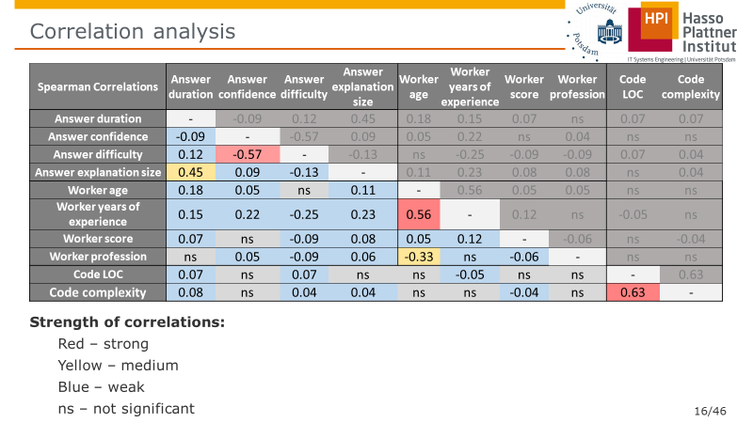
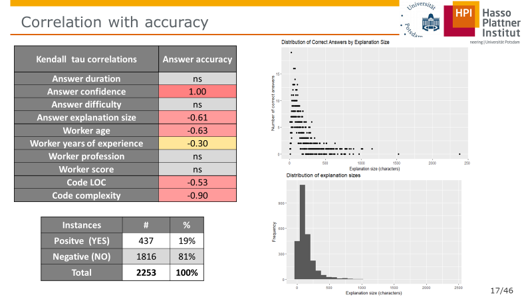
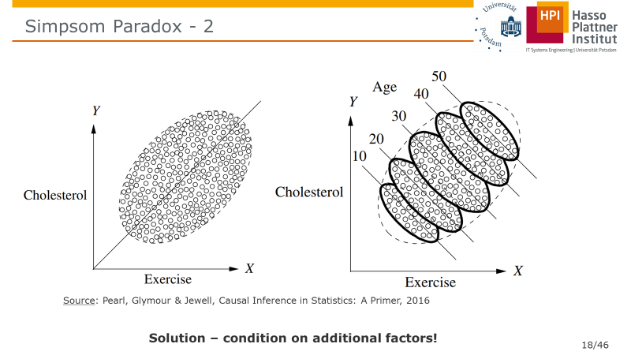
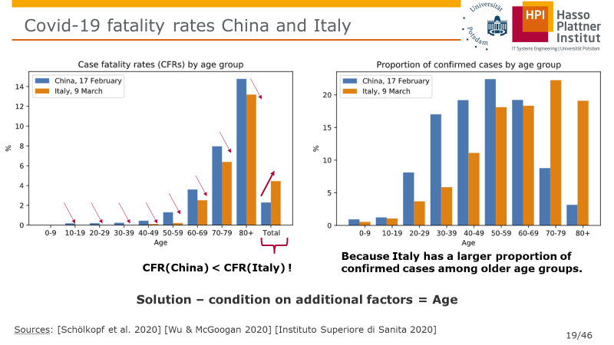
Finding predictive factors is a difficult problem

Slide 18
Correlation analysis
Spearman Correlations | Answer duration | Answer confidence | Answer difficulty | Answer explanation size | Worker age | Worker years of experience | Worker score | Worker profession | Code LOC | Code complexity
Answer duration | - | -0.09 | 0.12 | 0.45 | 0.18 | 0.15 | 0.07 | ns | 0.07 | 0.07
Answer confidence | -0.09 | - | -0.57 | 0.09 | 0.05 | 0.22 | ns | 0.04 | ns | ns
Answer difficulty | 0.12 | -0.57 | - | -0.13 | ns | -0.25 | -0.09 | -0.09 | 0.07 | 0.04
Answer explanation size | 0.45 | 0.09 | -0.13 | - | 0.11 | 0.23 | 0.08 | 0.08 | ns | 0.04
Worker age | 0.18 | 0.05 | ns | 0.11 | - | 0.56 | 0.05 | 0.05 | ns | ns
Worker years of experience | 0.15 | 0.22 | -0.25 | 0.23 | 0.56 | - | 0.12 | ns | -0.05 | ns
Worker score | 0.07 | ns | -0.09 | 0.08 | 0.05 | 0.12 | - | -0.06 | ns | -0.04
Worker profession | ns | 0.05 | -0.09 | 0.06 | -0.33 | ns | -0.06 | - | ns | ns
Code LOC | 0.07 | ns | 0.07 | ns | ns | -0.05 | ns | ns | - | 0.63
Code complexity | 0.08 | ns | 0.04 | 0.04 | ns | ns | -0.04 | ns | 0.63 | -
Strength of correlations:
Red – strong
Yellow – medium
Blue – weak
ns – not significant
Notes:
Strange correlations: Duration, Confidence, Difficulty. There is either very week correlation or we could not detect it (ns)
I first performed a correlation analysis to understand which features were significantly correlated to each other. Table below shows that only four pairs of features have medium (between 0.3 and 0.49) or high (between 0.50 and1.00) correlation values. The rest of feature pairs have low correlation or not significant ones (p-value<0.05).
These four correlation values are also intuitive. Answers with longer explanations (in characters) should have taken more minutes to be accomplished. Larger source code fragments also tend to be more complex. This makes sense because complexity was measured by counting the number of independent paths within the code fragment. (Cyclomatic Complexity [McCabe76]). Answers produced with less confidence were also considered more difficult (negative correlation). Finally, more experienced workers tend to be older (age).
McCabe (December 1976). "A Complexity Measure". IEEE Transactions on Software Engineering: 308–320. doi:10.1109/tse.1976.233837.

Slide 19
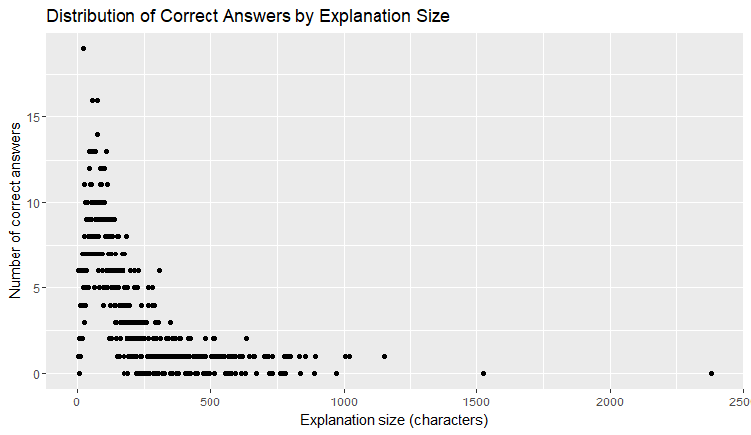
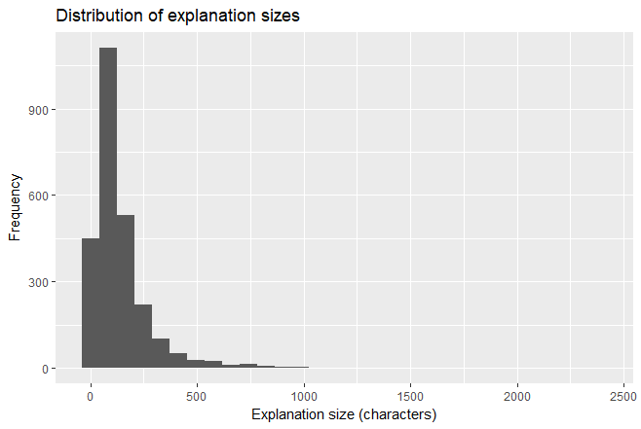
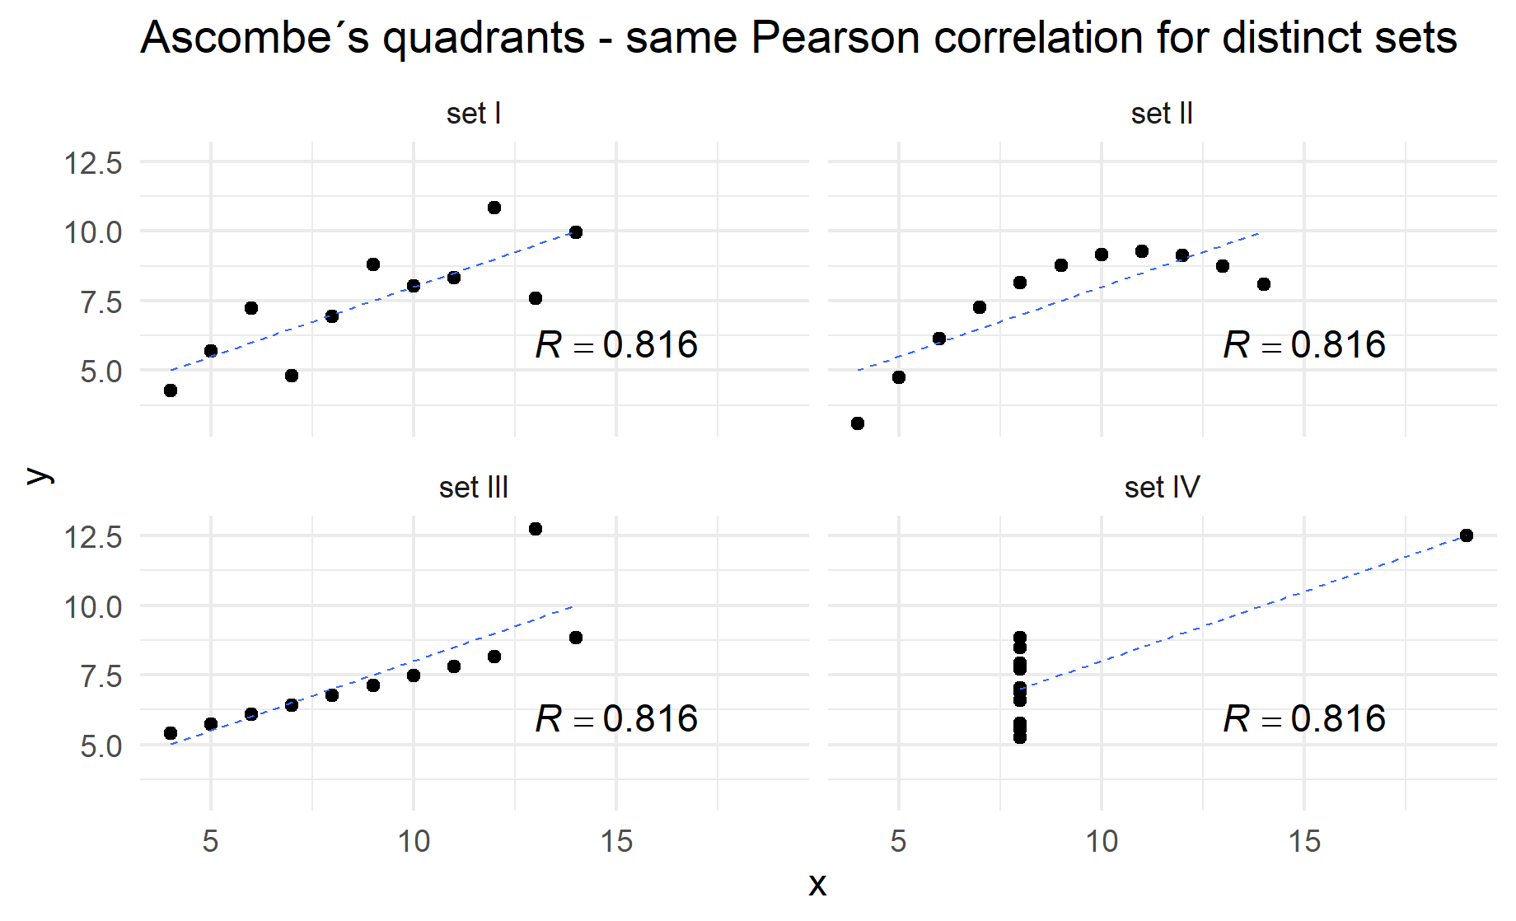
Spurious correlations with accuracy?
Kendall tau correlations | Answer accuracy
Answer duration | ns
Answer confidence | 1.00
Answer difficulty | ns
Answer explanation size | -0.61
Worker age | -0.63
Worker years of experience | -0.30
Worker profession | ns
Worker score | ns
Code LOC | -0.53
Code complexity | -0.90
Strong Skewness
Plot the other possible spurious correlations:
Difficulty
Experience
Do the same for E1
Class Imbalance
Instances | # | %
Positve (YES) | 437 | 19%
Negative (NO) | 1816 | 81%
Total | 2253 | 100%
Notes:
Two variables are independent when the value of one gives no information about the value of the other [Altman & Martin Krzywinski 2015]
When measuring multiple variables in a complex system, spurious associations can arise. Thus, association does not imply causation. Association consists of [Altman & Martin Krzywinski 2015].
[Altman & Martin Krzywinski 2015] Altman, Naomi, and Martin Krzywinski. "Association, correlation and causation." (2015): 899-900.
Note however, that we are actually interested in obtaining accurate answers. So, it also matters how each of these features compare in terms of their correlation with the frequency of correct answers. For that, we compute the correlation for the numeric features. For the non-numeric one, worker profession, we plotted the graph to show how accuracy varies from less to the most accurate profession.
Accuracy by individual answers aggregated by each feature can however be misleading. Take for instance, that explanation size is showed to be strongly inversely correlated with correct answer. Looking at the plot of correct answers by explanations sizes, we can see that the negative relation between the two variables resembles am asymptotic curve. The reason is that distribution of explanations sizes is right skewed, which could allow high values to distort the correlation measure. This can be seen in the chart with the long tail of explanations larger than 500 characters.
The conclusion is that feature selection is difficult to decide only by looking at one output variable to the whole data set. It is worth noting that accuracy is a biased measured for this data set because there are many negative instances (correct No answers) than positive instances (correct YES answers) as the table below shows. In other words, the probability of producing a correct answers by choosing not is 81%, while selecting YES has only 19% of being the correct choice. Moreover, since we are more interested in YES instances (where the fault is located) than NO instances, high accuracy does not imply that we got a large proportion of YES correctly.
The solution for that is to look used metrics that do not take into account the True Negatives (correct No’s) such as Precision and Recall. Precision measures the proportion of correct YES’s (True Positives) to wrong YES’s (True Positives + False Positives). Recall measures the proportion of correct YES’s (True Positives) to the total of expected correct YES’s (True Positives + False Negatives).

Slide 20
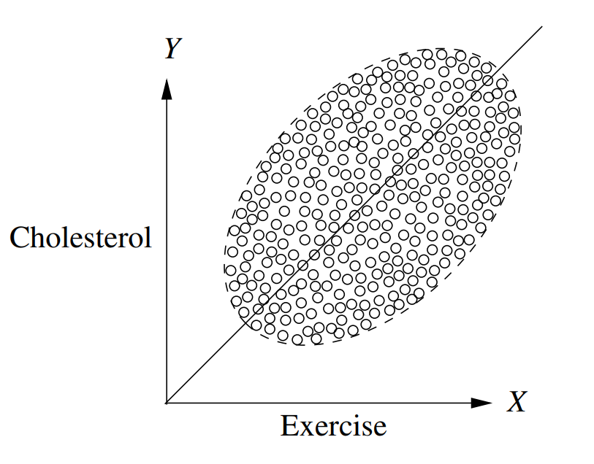
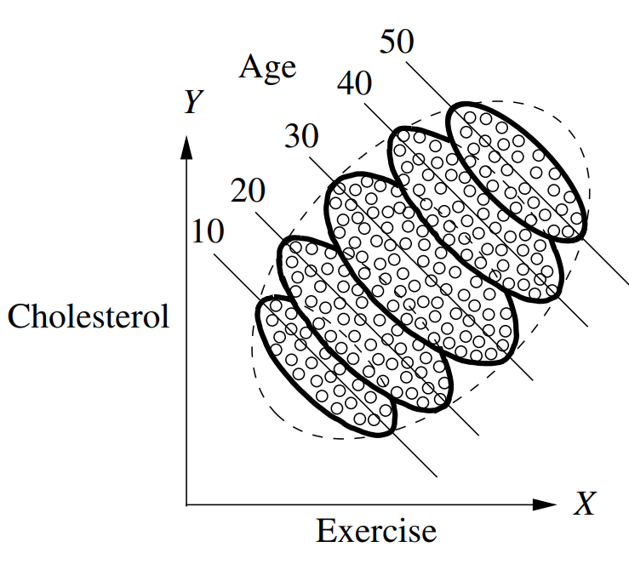
Simpsom Paradox
[Pearl, Glymour & Jewell 2016], Causal Inference in Statistics: A Primer.
Age
Solution – condition on age!
Exercise
Cholesterol
Notes:
Another good example is the length of comments on Reddit.
Barbosa, S., Cosley, D., Sharma, A., & Cesar Jr, R. M. (2016, April). Averaging gone wrong: Using time-aware analyses to better understand behavior. In Proceedings of the 25th International Conference on World Wide Web (pp. 829-841). International World Wide Web Conferences Steering Committee.

Slide 21
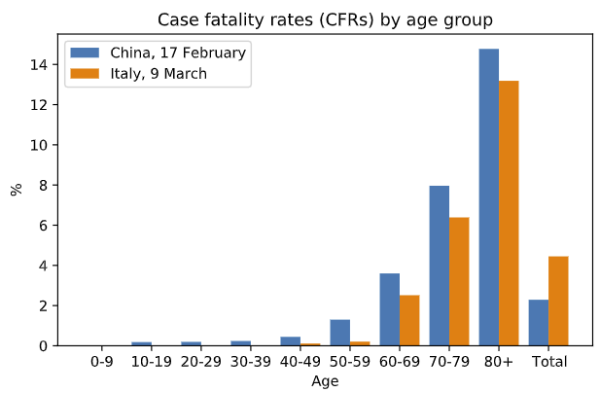
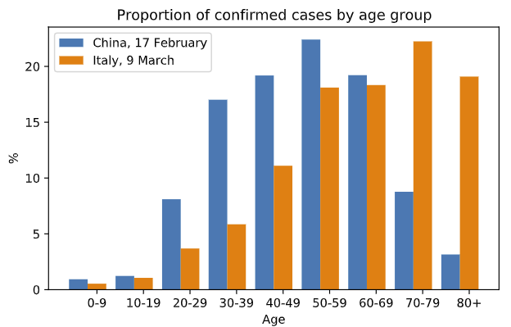
Simpson’s paradox Covid-19 fatality rates
Because Italy has a larger proportion of confirmed cases among older age groups.
CFR(China) < CFR(Italy) !
Country
Solution – condition on additional factors = Country
Total Effect of Country on CFR = Direct Effect + Indirect Effect
Age
CFR
Sources: [von Kügelgen, Gresele & Schölkopf et al. 2020] [Wu & McGoogan 2020] [Instituto Superiore di Sanita 2020]
Notes:
Country affects CFR via infrastructure for health care
Country afffects age
how can the disease in Italy be less fatal for the young, less fatal for the old, but more fatal for
the people overall?
[von Kügelgen, Gresele & Schölkopf et al. 2020] von Kügelgen, J., Gresele, L., & Schölkopf, B. (2020). Simpson's paradox in Covid-19 case fatality rates: a mediation analysis of age-related causal effects. arXiv preprint arXiv:2005.07180.
[Wu & McGoogan 2020] Zunyou Wu and Jennifer M McGoogan. Characteristics of and important lessons from the
coronavirus disease 2019 (COVID-19) outbreak in China: summary of a report of 72 314
cases from the Chinese Center for Disease Control and Prevention.
Jama, 2020.
[Instituto Superiore di Sanita 2020] Instituto Superiore di Sanita. Epidemia COVID-19: Aggiornamento nazionale, 09 Marzo 2020 – ore 16:00. https://www.epicentro.iss.it/coronavirus/bollettino/Bollettino-sorveglianza-integrata-COVID-19_09-marzo-2020.pdf
, 2020
Quote from [Scholkoepf et al. 2020] “How can such a pattern be explained? The key to understanding the phenomenon lies in the fact
that we are dealing with relative frequencies: the CFRs shown in percent in Fig. 1a are ratios and
correspond to the conditional probabilities of fatality given a case from a particular age group and
country. However, such percentages conceal the absolute numbers of cases within each age group.”

Slide 22
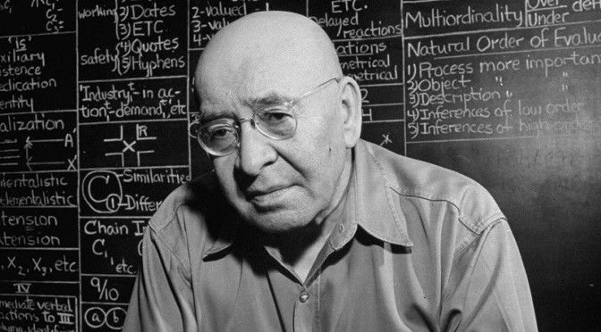
Towards Causal Mechanisms
“A map is not the territory it represents, but, if correct, it has a similar structure to the territory, which accounts for its usefulness.”
― Alfred Korzybski, Science and Sanity: An Introduction to Non-Aristotelian Systems and General Semantics
Notes:
“If words are not things, or maps are not the actual territory, then, obviously, the only possible link between the objective world and the linguistic world is found in structure, and structure alone.”

Slide 23
Hypothesized Causal Graph
{intervention}
Type of task (Bug/No Bug)
{exogenous}
Code complexity
{endogenous}
Difficulty
{endogenous}
Explanation size
{exogenous}
Programmer skill
{endogenous}
Duration
Besides being small-world representation, a graph allows for the discovery of structural properties of the probability models.
However, the number of possible graphs still grows very fast
{endogenous}
Confidence
{endogenous}
Answer type
{outcome}
Accuracy
Notes:
However, nodes can be arranged in many different. Three nodes can be arranged in 25 different acyclic graphs (DAG), 4 nodes can compose 543, and 5 nodes 29281 DAGs, 6 nodes 3781503, and 7 to 1138779265 DAG. Yes, but how to know which is the correct mechanism?
7 nodes = 4 million graphs
8 nodes = 800 billion graphs
9 nodes = 1,548 times more

Slide 24
Brute force search does not scale
7 nodes = 4 million graphs
8 nodes = 800 billion graphs
9 nodes = 1,548 times more
(or 1.2 10^16 graphs)
source: [Sloane 2019]
Notes:
Hence, we need to be able to refine a graph model, for that we need a set of operations and properties so we can test hypotheses about graph dependencies and independencies
[Sloane 2019] N. J. A. Sloane, Number of acyclic digraphs (or DAGs) with n labeled nodes, in The Online Encyclopedia of Integer Sequences, available at http://oeis.org/A003024/b003024.txt (accessed May 2019)
However, nodes can be arranged in many different. Three nodes can be arranged in 25 different acyclic graphs (DAG), 4 nodes can compose 543, and 5 nodes 29281 DAGs, 6 nodes 3781503, and 7 to 1138779265 DAG. Yes, but how to know which is the correct mechanism?
7 nodes = 4 million graphs
8 nodes = 800 billion graphs
9 nodes = 1,548 times more (or 1.2 10^16 graphs)

Slide 25
Epistemological Challenges
How to generate plausible alternative hypotheses of the causal mechanisms of fault understanding?
How to falsify these hypotheses in a rigorous and reproducible way?

Slide 26
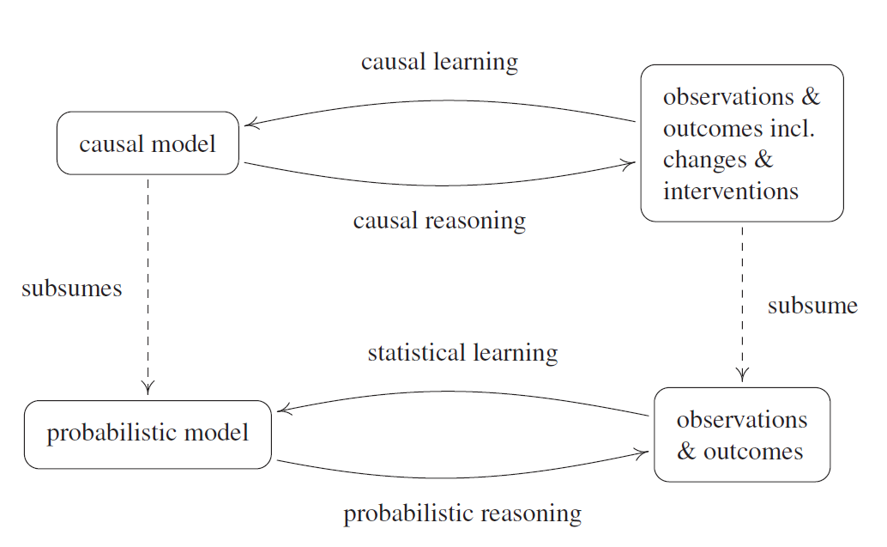
Overall approach to causal inference
source: Peters, J., Janzing, D., & Schölkopf, B. (2017). Elements of Causal Inference: Foundations and Learning Algorithms. MIT Press.
Notes:
@book{peters2017elements, title={Elements of Causal Inference: Foundations and Learning Algorithms}, author={Peters, Jonas and Janzing, Dominik and Sch{\"o}lkopf, Bernhard}, year={2017}, publisher={MIT Press} }

Slide 27
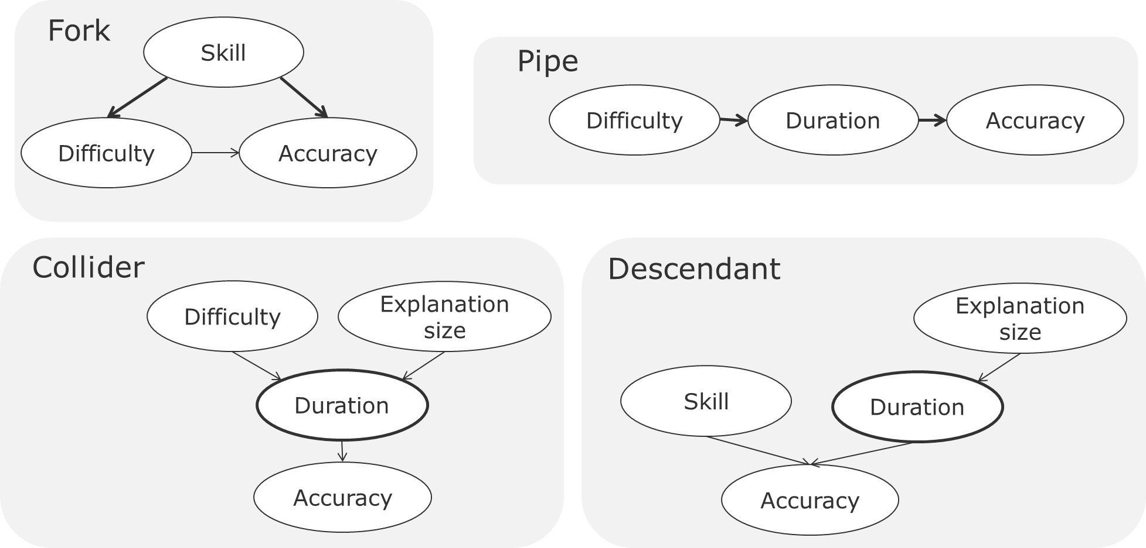
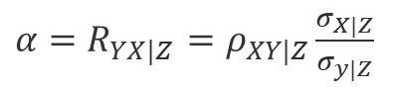
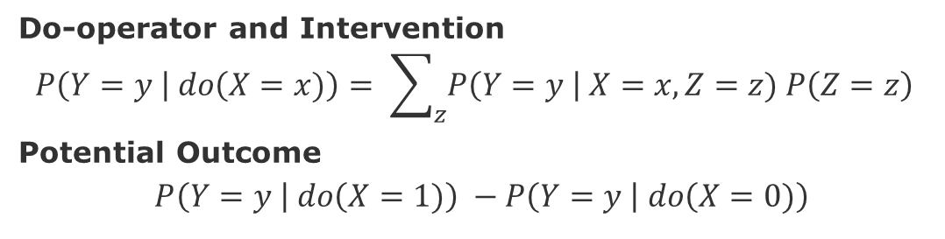
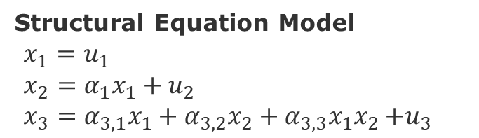
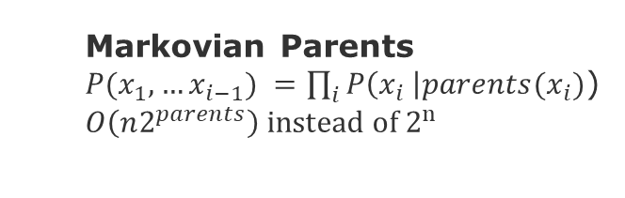
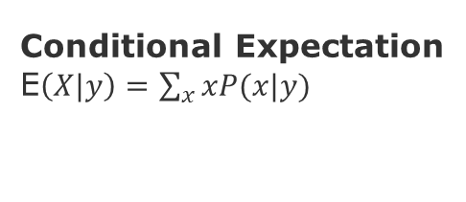
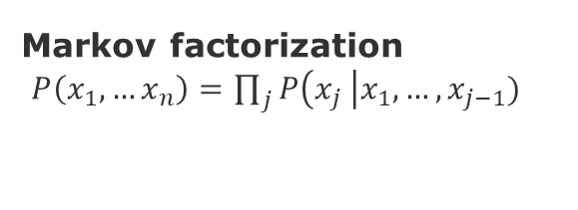
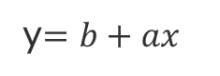
Overall approach to causal inference methods
Graph patterns
Do-operator and Intervention
$$P\left(Y=y \right| do\left(X=x)\right)= \sum_{z}{P\left(Y=y \right| X=x, Z=z) P\left(Z=z\right) }$$
Potential Outcome
$$P\left(Y=y \right| do\left(X=1)\right) −P\left(Y=y \right| do\left(X=0)\right)$$
Markov factorization
$P\left(x_{1},…x_{n}\right)=\prod_{j}{P\left(x_{j} \right|x_{1},…,x_{j−1})}$
Causal Inference Assumptions:
Ignorability (no confounders)
Positivity (no imbalances)
Modularity (stable unit of treatment)
Consistency (compliance)
Exclusiveness (effective intervention)
Markovian Parents
$P(x_{1},…x_{i−1}) =\prod_{i}{P\left(x_{i} \right|{parents(x}_{i})}$)
$O\left(n2^{parents}\right) instead of 2^{n}$
Conditional Expectation
E$\left(X|y\right)=\sum_{x}{xP(x|y)}$
Regression
Structural Equation Model
$x_{1}=u_{1}$
$x_{2}=α_{1}x_{1}+u_{2}$
$x_{3}=α_{3,1}x_{1}+α_{3,2}x_{2}+α_{3,3}x_{1}x_{2}{+u}_{3}$
y$=b+ax$
${α=R}_{YX|Z}$ $=ρ_{XY|Z}\frac{σ_{X|Z}}{σ_{y|Z}}$
[Peters, Janzing, & Schölkopf 2017] Elements of Causal Inference: Foundations and Learning Algorithms. MIT Press.
Notes:
@book{peters2017elements, title={Elements of Causal Inference: Foundations and Learning Algorithms}, author={Peters, Jonas and Janzing, Dominik and Sch{\"o}lkopf, Bernhard}, year={2017}, publisher={MIT Press} }
Ignorability = Given the background variable, X, treatment assignment W is independent to the potential outcome
Positivity = For any value of X, treatment assignment is not deterministic
Modularity (Stable Unit Treatment Value Assumption SUTVA) = The potential outcomes for any unit
do not vary with the treatment assigned to other units, and, for each unit, there are no different forms or versions of
each treatment level, which lead to different potential outcomes.

Slide 28
Causal Mechanisms Discovered

Slide 29
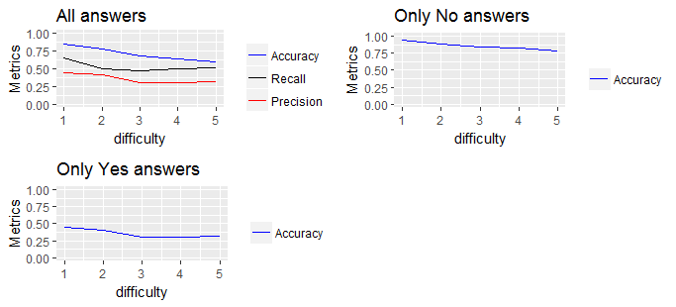
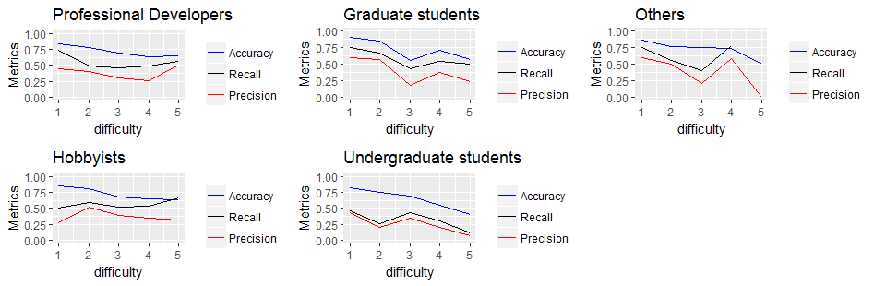
Difficulty x Accuracy
Difficulty is inversely proportionate to accuracy across all levels of difficulty

Slide 30
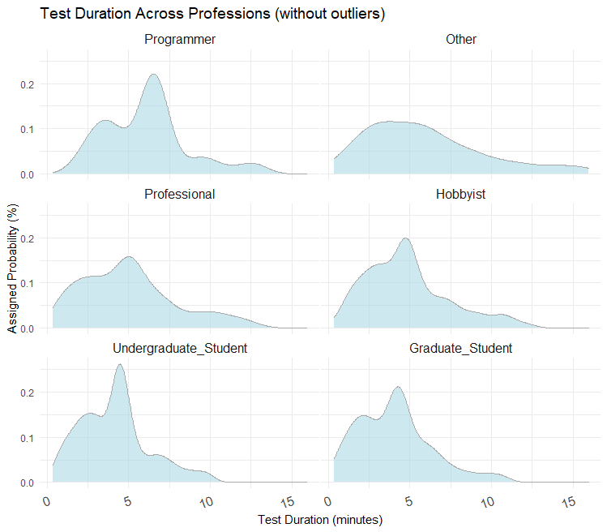
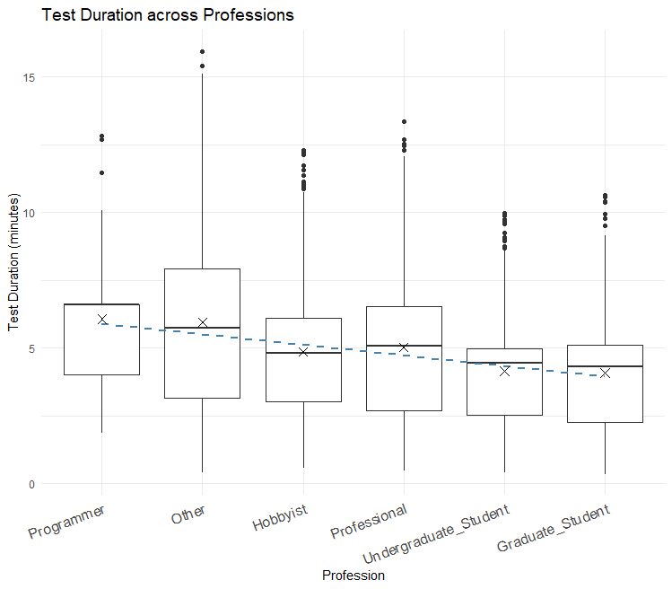
Task duration across professions
Notes:
Outlier -
"Replace all values that are above the upper whisker for the median time of
each professional group“
Except for “Other”, all groups present bimodal distributions. This might imply that regardless of the profession, we have two groups of subjects with respect to the time that they invested in doing the qualification test. The more pronounced bimodal figure is among the professionals. More time to answer question might reflect thoroughness or cluelessness. To evaluate that we need to measure the relation between test duration and the qualification score. However, simply computing a correlation or a univariate linear regression might not work because of the confounding of Profession or even the other covariates Age and Years of Programming.

Slide 31
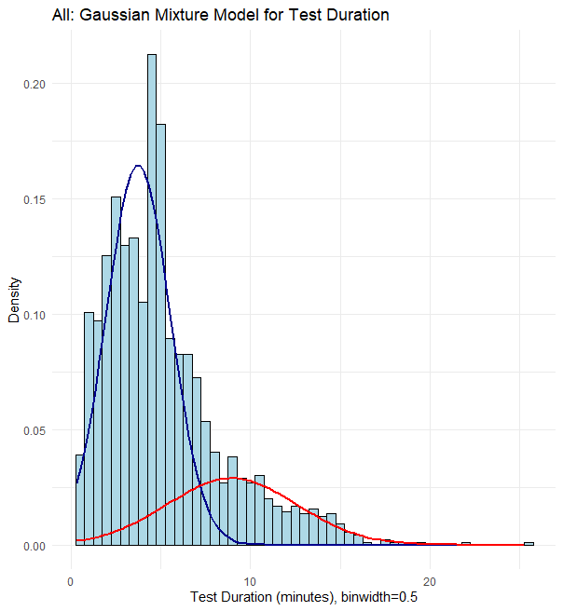
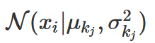
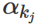
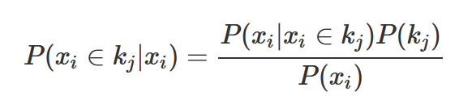
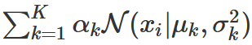
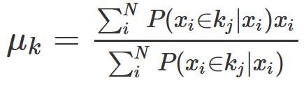
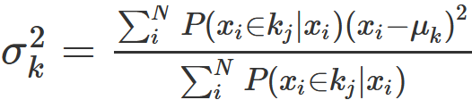
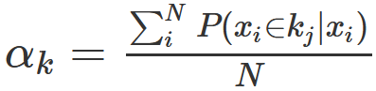
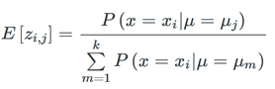
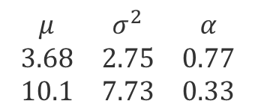
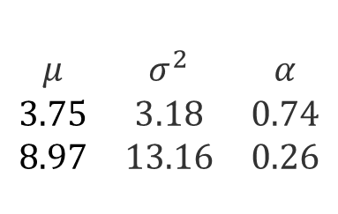
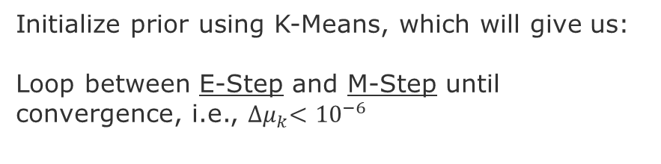
Gaussian Mixture Model with the Expectation Maximization algorithm
E-STEP
$$\begin{matrix}μ & σ^{2} & α \\ 3.75 & 3.18 & 0.74 \\ 8.97 & 13.16 & 0.26\end{matrix}$$
1=blue
2=red
M-STEP
Membership to cluster kj
$$\begin{matrix}μ & σ^{2} & α \\ 3.68 & 2.75 & 0.77 \\ 10.1 & 7.73 & 0.33\end{matrix}$$
Initialize prior using K-Means, which will give us:
Loop between E-Step and M-Step until convergence, i.e., ${∆μ}_{k}<{10}^{−6}$
1=blue
2=red

Slide 32
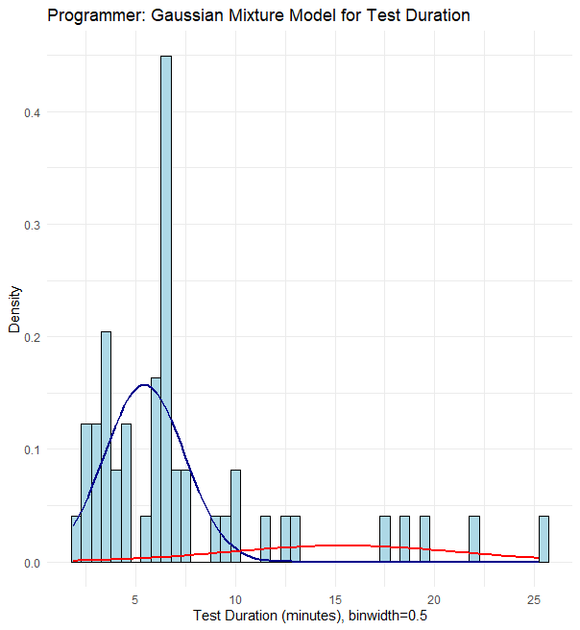
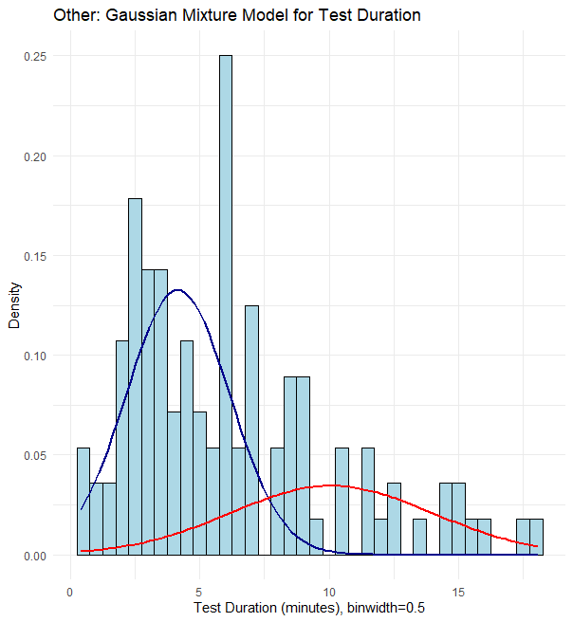
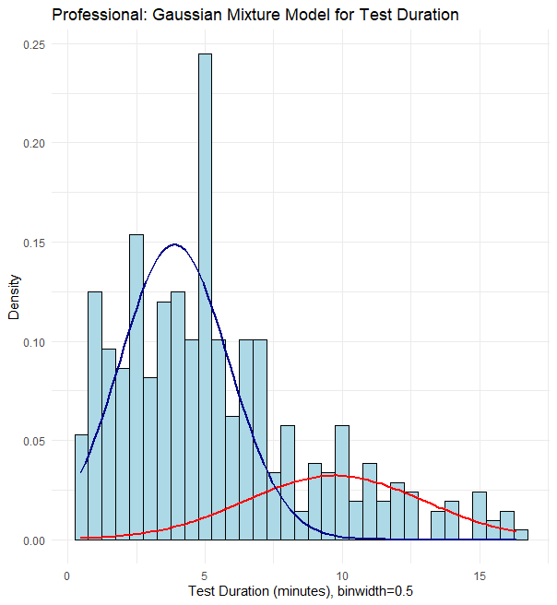
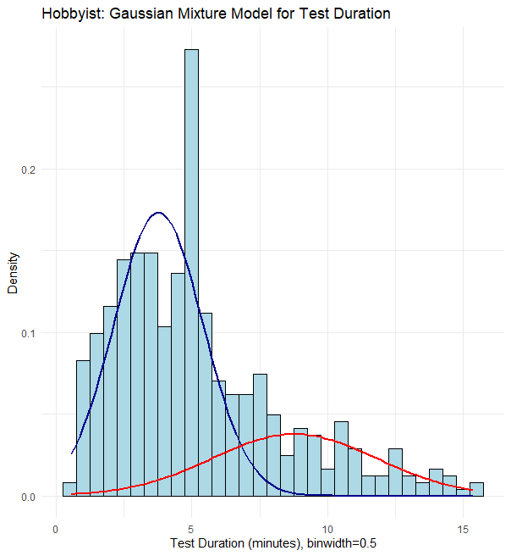
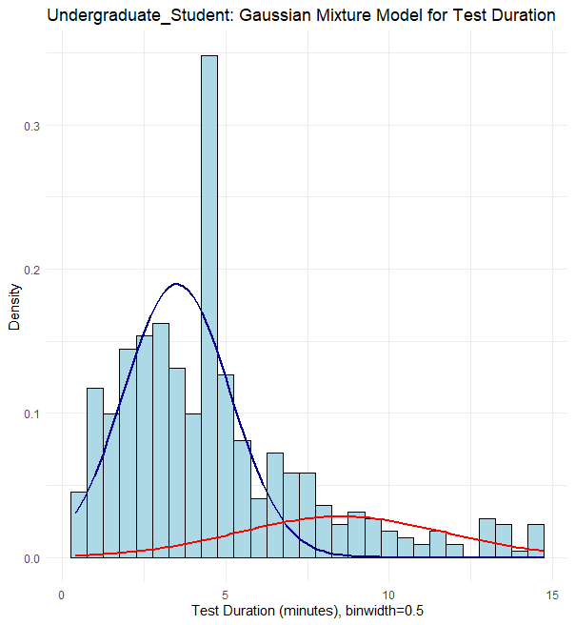
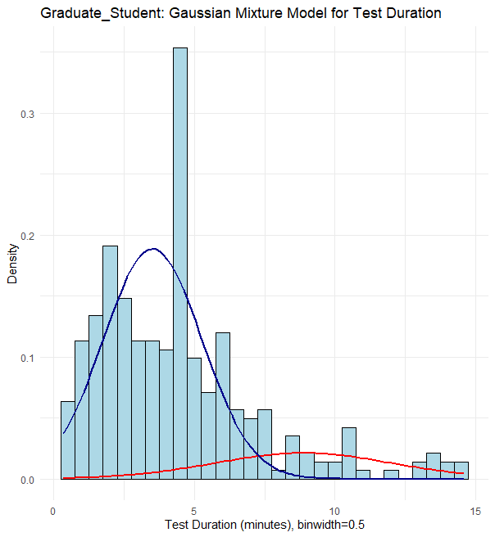
Gaussian Mixture Model by Profession
Proportion (Blue,Red), Blue ϵ fast-cluster, Red ϵ slow-cluster
(36,13)
(101,11)
30%
10%
(417)
(440,44)
100%
10%
(384,59)
(260,23)
15%
10%

Slide 33
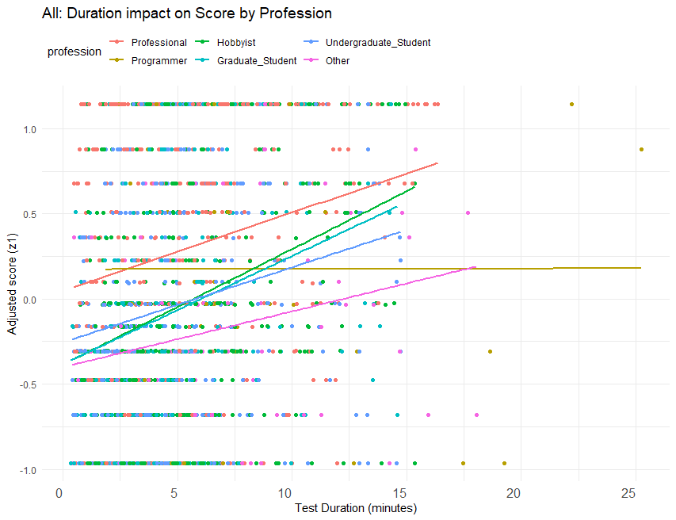
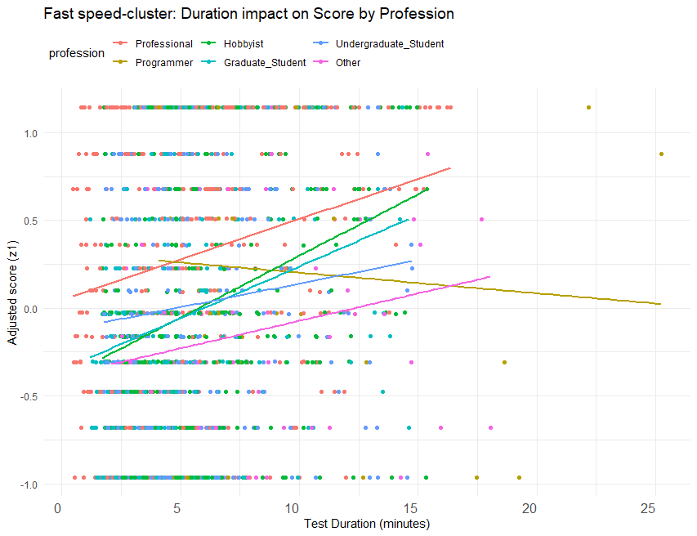

Effect of duration on score by speed-cluster
Mixture Model membership is a confounder of the effect of task duration on score.
Profession
Speed-Cluster
Duration
Score (z1)
Notes:
This confounder reverses the signal of the effect for Students and Other.who are the professions with lowest score.

Slide 34








Causal Discovery: Constraint and Score-Based Methods
Notes:
Fast Speed-Cluster

Slide 35
Results after conditioning and intervening
Can we detect groups of programmers who located all faults?
Yes
# rank | Filters (by conditioning) | precision, recall | lines to inspect | workers | answers
1 | non-students score = 100% | 94%, 65% | 51 | 133 | 836
2 | only score = 100% | 94%, 65% | 51 | 194 | 1121
3 | least difficult answers by worker score | 88%, 61% | 42 | 418 | 1868
4 | all non-students | 81%, 76% | 56 | 316 | 1173
5 | least difficult answers by worker profession | 81%, 61% | 43 | 454 | 2279
6 | all programmers | 79%, 64% | 43 | 497 | 2580
7 | excluded fastest answers | 78%, 59% | 41 | 488 | 2395
8 | top 3.3% confidence answers | 71%, 56% | 42 | 412 | 1749
9 | excluded shortest explanations | 70%, 66% | 57 | 412 | 1879
32 minutes for 8 bugs
5 minutes per bug
104 USD per bug
Notes:
We applied filters for other sets of features. I filtered workers by test score, profession, and years of experience. Answers were filtered by duration, confidence, difficulty, explanation size.
After applying a set of filters, we obtained different subgroups of workers that we call subcrowds, who also located all 8 faults, but with different levels of precision and recall. Table-x shows 8 of these subcrowds in detail. We can see in the table that a subcrowd composed solely by non-students had the highest F1 score. Notice also that these subcrowds are not disjoint sets, for instance, >80% score non-students contain the subcrowd of 100% score students, therefore, they have different number of workers, which imply different costs.

Slide 36




How many feasible interventions?
R2 = -0.31
Non-significant correlation
R2 = -0.59
R2 = -0.61

Slide 37
Causal Mechanisms in Time: Sequential Decision Models

Slide 38


How these causal mechanisms generalize over time?
Approach: a sequential decision model that utilizes the discovered causal mechanisms
Recruitment
Qualified programmer
Programmer
Task assignment
Code inspection
Task outcome
Voting
Task
Fault identification
Task generation
Bug
Task list
Convergence/ Stopping model
When to stop inspection?
Sequencing model
What to inspect next?
Explore or Exploit?
Causal
model
Multi-Armed Bandit
AI/Machine Learning
Components
Notes:
Recruitment: consists posting the job, obtaining candidates’ agreement to participate in the study, collecting demographic information from the participantes, and having these participants take a programming exam. In the instances of the experiment, there we no selection of participant based on their demographics.
Task generation: consist of processing the information of a bug, which corresponds to the software failure message, the unit test, the source code that failed the unit test (a Java method, caller and callee methods). The processing consists of instantiating tasks based on a set of template questions (8 in the first experiment and 4 in the second). The decision of which tasks to be instantiated depends on the control signal (more on this later) as shown in the figure.
Task assignment: consists of matching a task to a programmer. The matching is decided based on programming skill and task complexity. The programming skill is a composition of the outcomes of the programming exam, years of programming experience, and the persons profession (professional programmer, hobbyist, graduate student, undergraduate student, other). The task complexity is measured using the Halstead code complexity metric. The matching can be parameterized only by a control signal (more later).
Code inspection: consists of graphical user interface (GUI) that gives the programmer access to the source code and the software failure. The GUI also presents a specific question about the relationship between a particular program statement, which is highlighted in yellow in the source code. Below the question there are input fields for the programmer to answer. The answer corresponds to a Yes (the highlighted program statement is related to the failure), No, or I don’t Know. Additionally the programmer must write an explanation, provide level of confidence on her answer, how difficult she perceived the question to be. On the background the GUI measures how it took the programmer from opening the task to submiting it, which generates a task outcome that is an input to the control module (more later).
Voting: consists of two steps – (1) aggregating multiple answers from the same question and (2) ranking the corresponding program statements that were deemed more suspicious with respect to harboring the fault. We designed different types of voting mechanisms (more later). Voting produces two outcomes, one is the fault identification, whic
Control agent
The control module is responsible to learn how to steer the execution environment. This happen through three learning models: convergence model, sequencing model, and intervention model. Differently from the components in the execution enviroment, the components in the control agent are called models, because they do not have a deterministic mechanism. Instead, the control components have different probabilistic mechanisms. They are probabilistic in a sense that the actions are not deterministic given the inputs. The actions correspond to changes in the configurations of the components responsible for task generation and task assignment. Next, we detailed each of the control components.
Convergence model: consists of probabilistic model that estimates the rate of convergence towards a fault identification outcome. The goal of the convergence model is to decide when to stop generating and assigning certain tasks (or all tasks all together). The convergence model interacts with the sequencing model to simulate the outcome of hypothetical task executions. The convergence model learns based on two sets of inputs, the outcome of a tasks and the current list of suspicious program statements produced by the voting component. The convergence model is specified by a set of mathematical formulas and an algorithm, which we detail later.
Sequencing model: consists of a probabilisic model that chooses the next task that should be executed and by whom in order to minimize the number of tasks needed to identify the fault. This minimization goal has two subgoals, (1) identify a unique program statement as the one harbouring the fault and (2) reduce the uncertainty (variance) about this classification. This involves balancing exploration and exploitation. The exploration correspond to executing tasks that have weak signal concerning the fault, for instance, few answers or answers with low confidence. Hence, the goal of exploration is to reduce classification bias by minimizing the risk of overlooking a possible location of a fault (false negatives) The exploitation corresponds to executing tasks that have strong signal, for instance, high confidence, low difficulty, lengthy explanations, and many answers. The goal of exploitation is to reduce classification variance by minimizing the risk of misdiagnosing a program statement as faulty (i.e., false positives). We investigated different sequential decision algorithms based on multi-armed bandits, which we detail later.
Intervention model: consists of a probabilistic model that determines where to intervene and to which degree in order to obtain the larger impact on the accuracy of the task outcomes. By intervene we mean to determine the values of certain variables (called covariates) that hold a causal relationship with the goal represented by an outcome variable. For this reason, the intervention model is based on a causal model and a set of intervention intruments. The causal model is learned from data and the intervention instruments are determined from domain-knowledge. The causal model consists of a Bayesian network, where the nodes are features about the programmer (years of experience, qualification score, and profession), the bug (source code complexity), and the task (duration, explanation, confidence, and difficulty). The causal model is learned from data using hierarchical Bayesian regression methods. The intervention instruments specify how a covariate can be manipulated, i.e., has its values modified while all the other covariates are left unchanged. This requires domain-knowledge about the assumptions that can be made with respect to identifiability, stability, modularity, and ignorability of the cause-effects of manipulating one or multiple covariates. Intervention is necessary not only to steer the process, but also build confidence on the ability of the causal model to make inferences about the phenomenon of fault understanding at the task type level. Conversely the voting model is responsible to make inferences about the coarser grain phenomenon of the fault identification consensus across different tasks.

Slide 39



Sequential Decision-Making Algorithm
Multi-Armed Bandit selects at each round of play one of K arms each with unknown reward distribution.
Goal: maximize the cumulative expected rewards over a time horizon (T).
Challenge: Explore vs Exploit
(U1, A1, R1)

Slide 40



Confidence-based Utility function
C$onfidence U\left(qi\right)=c1(qi$) + $2∗c2(qi$) +$0∗c3(qi$) + $4∗c4(qi$)+ $5∗c5(qi$)
Can we locate all faults by minimizing replication?
Yes
92% precision and 100% recall with 20% of the tasks

Slide 41






Difficulty-based Utility function
Utility Function $U\left(qi\right)=5∗d1(qi$) + $4∗d2(qi$) +$0∗d3(qi$) + $2∗d4(qi$) - $1∗d5(qi$)

Slide 42

Extension to Contextual Bandits
Expected Utility = U P(𝑟^{qi} | 𝜃)
Utility from a given causal mechanism, e.g.,
Confidence, Difficulty, Qualification Score
Probability of Yes Answers
Computed using the
Thompson Sampling Bandit
Benefits
Uses prior knowledge (belief)
Updates this knowledge as we are faced reality
Keeps some level of skepticism about the reality
for each question given some parameter 𝜃.
P(𝑟^{qi} | 𝜃) is a distribution parameterized by 𝜃
Source: Silver, https://www.davidsilver.uk/wp-content/uploads/2020/03/XX.pdf

Slide 43


Thompson Sampling Bernoulli Bandit
Sample (implicit Exploration)
Exploit
Belief update

Slide 44


Utility versus Expected Utility Bandit
Utility
Expected Utility

Slide 45




Difficulty Utility Convergence

Slide 46






Convergence by Programming Qualification Score
Score=3
Score=4
Score=5

Slide 47

RP.3 Impact of Fault Understanding on bug fixing
Do explanations make bug fixes more accurate?
21 programmers, average of 11.7 years of experience
Statistic | No Explanation | Root-Cause | Fault removal
Accuracy | 46% | 81% | 100%
Statistic | No Explanation < Root-cause | Root-Cause < Fault removal | No Explanation < Fault removal
p-value | 0.012 | 0.018 | 0.00001
Cohen-d | 0.74 | 0.68 | 1.48
Strength | Large | Large | Large
pos-hoc Power | 48% | 43% | 94%
Yes, but only for explanations that reflect fault understanding

Slide 48
Summary of Research Problems
RP.1: What are the factors related to the correct identification of a software fault?
30 different combinations of factors that are composed into different causal models
RP.2: How many replications are necessary until we correctly recognize a software fault?
On average 4 times (20% x 20)
RP.3: Are programmers more accurate in their bug fixes if they have access to the explanations?
Yes, for explanations about root-cause and fault removal

Slide 49
Summary of Contributions
Causal mechanisms that allow to plan interventions and explain outcomes counterfactually
Sequential decision models that allow to simulate the cost and accuracy of the code inspection process tasks
Datasets from three large experiments with real bugs and programmers with diverse programming skill experience and background
Software - Web-based platform for experiments on code inspection tasks

Slide 50
Future Work
Extend the decision model to consider cost and availability of programmers
Relax the assumptions of ignorability (lack of unobserved confounders)

Slide 51
End
Publications by me (Christian Adriano)
“Exploring microtask crowdsourcing as means to fault localization”, Arxiv 2017.
“Learning Utility Changes for Rule-based Self-Adaptive Systems“, published at ICAC, 2018.
“Microtasking Fault Localization“, published at ACM Sigsoft Eng. Notes, 2019.
“Collective Risk Minimization via a Bayesian Model for Statistical Software Testing, SEAMS, 2020

